Slide 1
MEMORY PUZZLE GAME USING AI
07:Atharva Mahabal
05:Atharva Tanawade

Slide 2
Introduction
Memory Puzzle Game is the best brain exercise as it helps in enhancing the memory and concentration of the player. It is a popular game. Let’s start developing a memory puzzle game in Python and learn some concepts.

Slide 3
About memory puzzle game
In this game we will create 3 levels: easy, medium and hard.
At the start of the game the shapes are hidden. The player clicks on the tiles to uncover the tile and when two similar tiles are uncovered the score increases.
To complete the game the user has to uncover all the pairs of shapes.
After completion of the game, the number of moves required to complete the game is also displayed on the screen.

Slide 4
The process
We used heuristic algorithm to make grids and select and vanish process to change the shapes according to the tiles.
Basic concepts of python,ai and tkinter are required to get ahead with the project.
A* algorithm can be used to keep the pairs present.

Slide 5
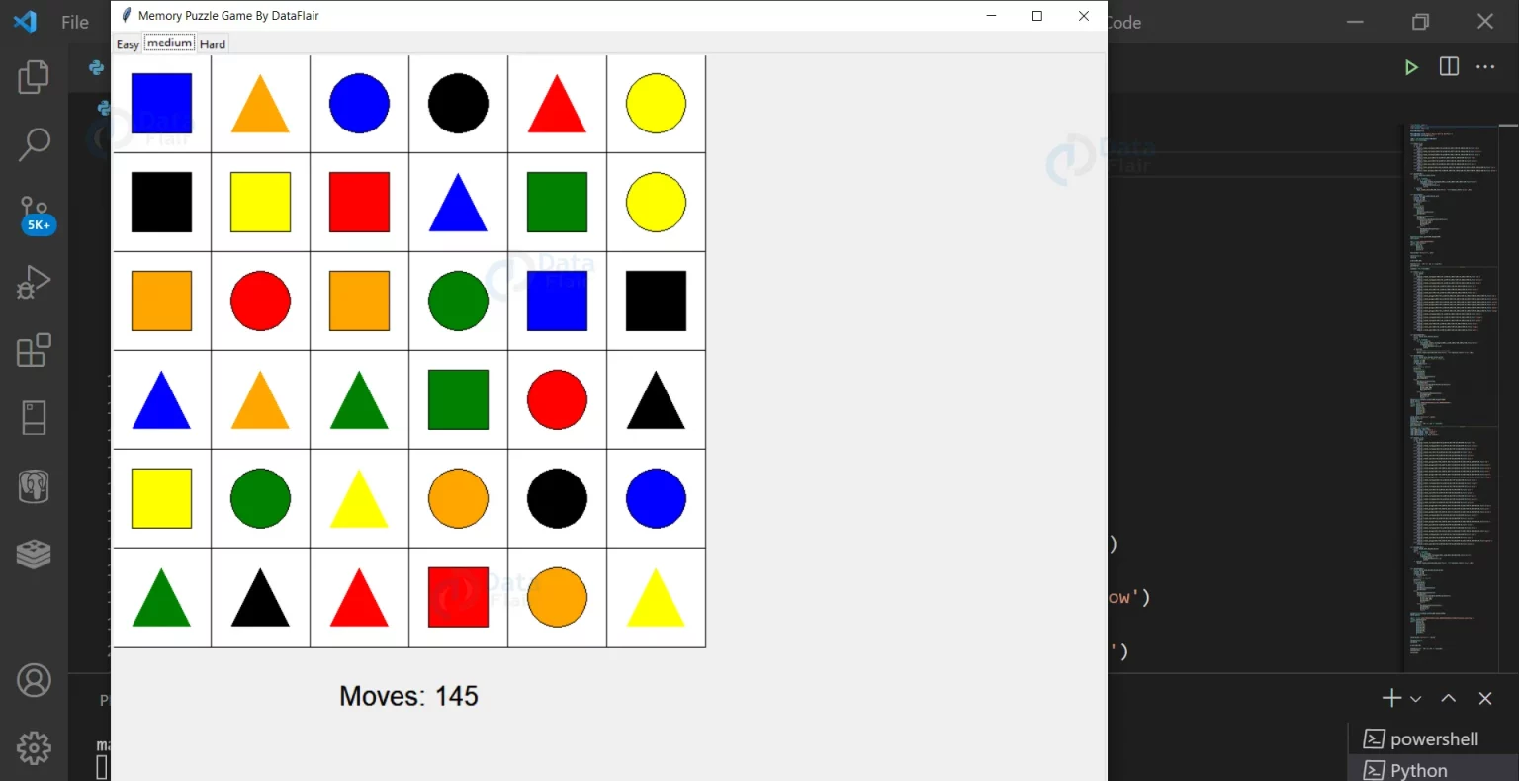
output

Slide 6
conclusion
We have successfully developed a memory puzzle game with the knowledge of AI, tkinter and python.

Slide 7
THANK YOU

